Slide 1
RNN
指導教授：呂芳懌
學生：呂奕珣

Slide 2
應用
有順序之分的資料
影像pixel
音訊
時間序列
自然語言

Slide 3
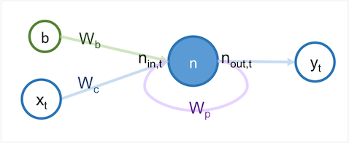
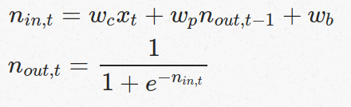
基礎RNN(vanilla RNN)

Slide 4
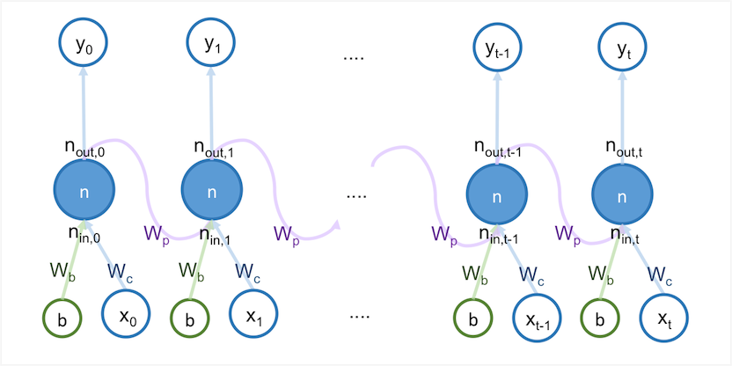
RNN

Slide 5
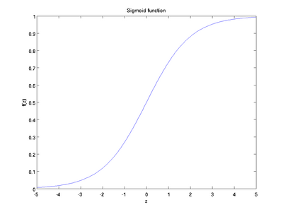
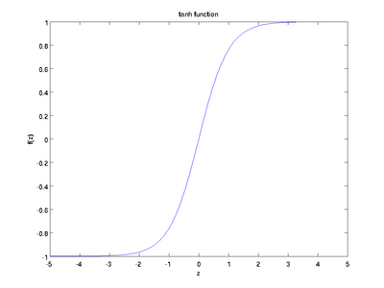


Activation function
Sigmoid function
Tanh

Slide 6

Cost function(mean-squared-error)
cost function是各個樣本的loss funcion的平均

Slide 7
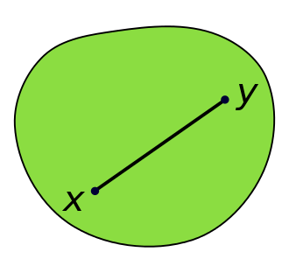
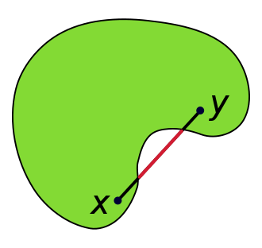
名詞解釋convex
convex
non convex

Slide 8
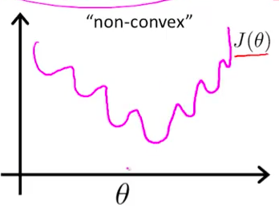
cost function問題
non-convex optimization is at least NP-hard
local optimal solution
global optimal solution

Slide 9
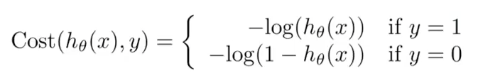
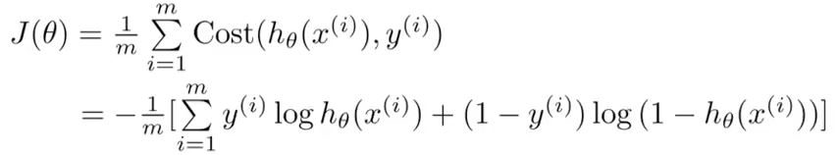
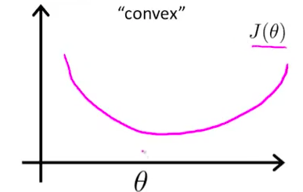
cost function使用cross entropy解決

Slide 10
基礎RNN缺點
梯度消失（gradient vanishing problem）
梯度爆炸（gradient exploding problem）

Slide 11
LSTM RNN
Long Short-Term Memory是一種RNN 延緩記憶退化

Slide 12
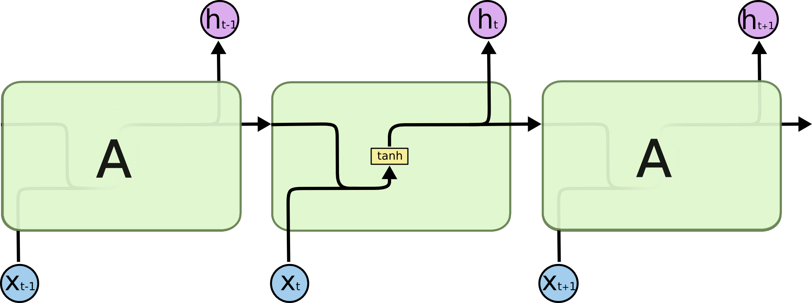
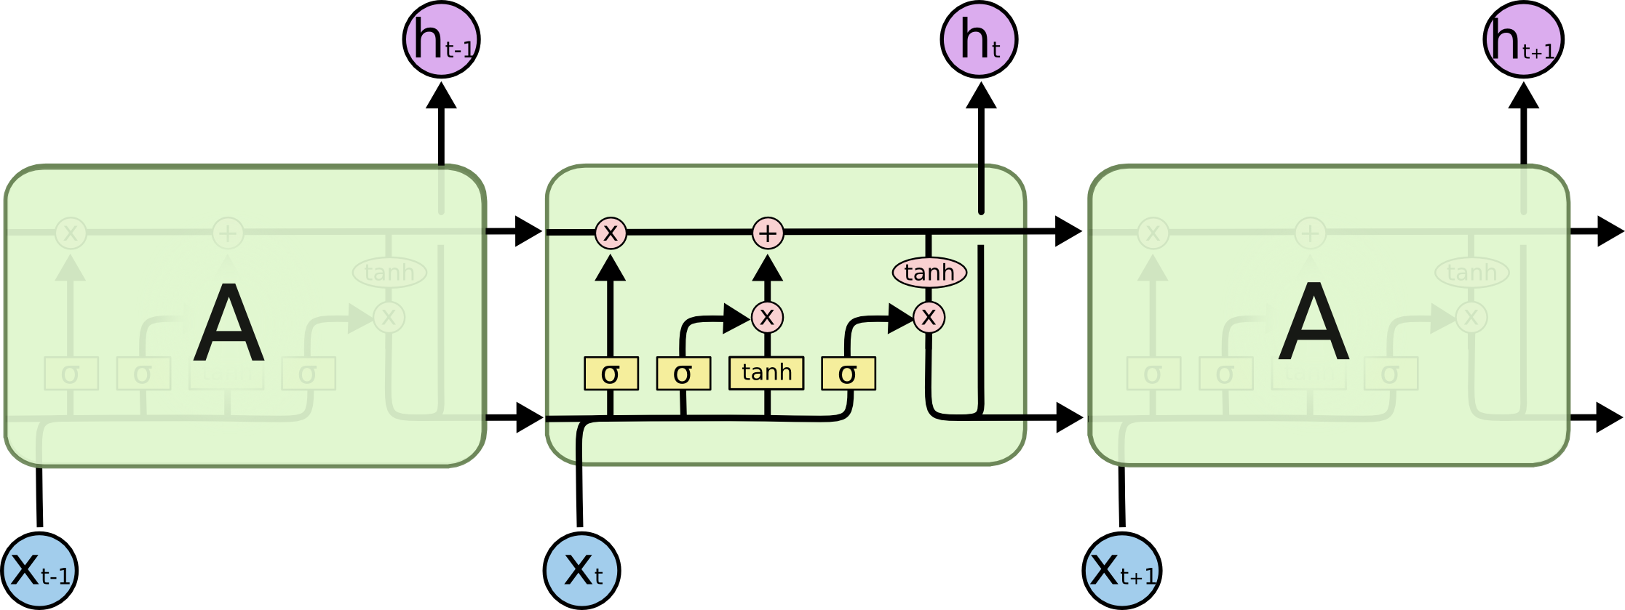
RNN &LSTM RNN
RNN
LSTM RNN

Slide 13
LSTM RNN

Slide 14
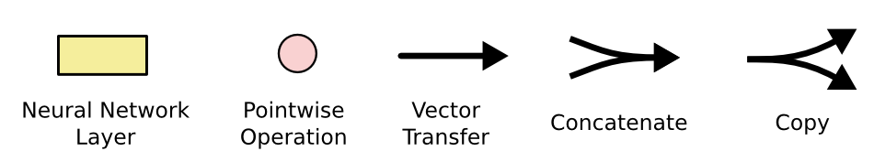
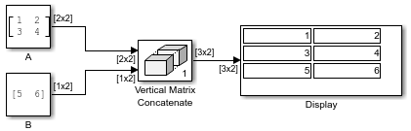
圖示介紹

Slide 15
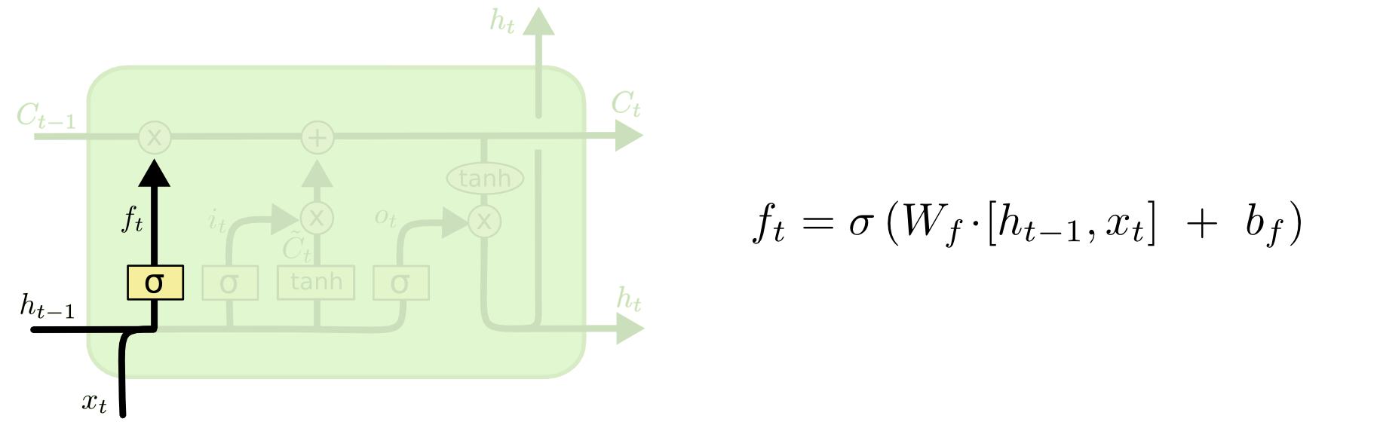
forget gate layer

Slide 16
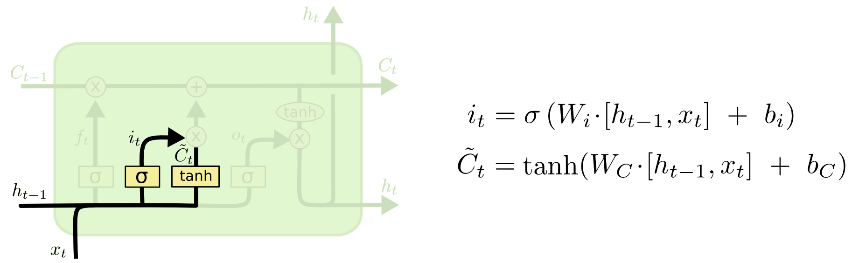
input gate layer

Slide 17
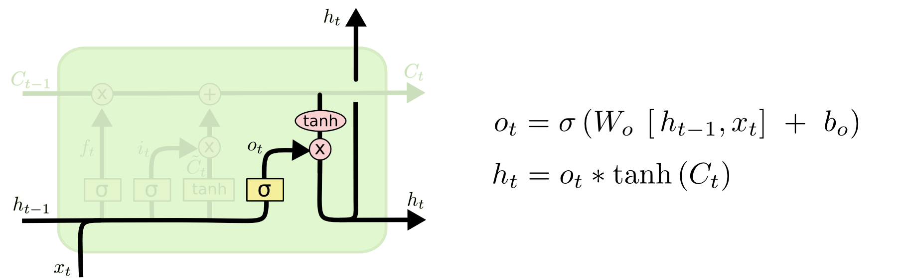
Output layer

Slide 18
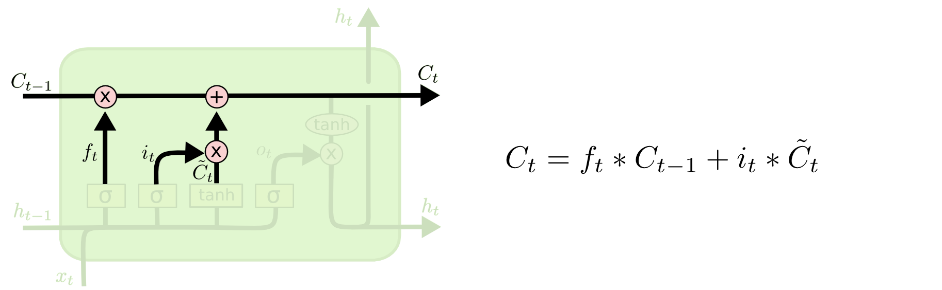

Slide 19
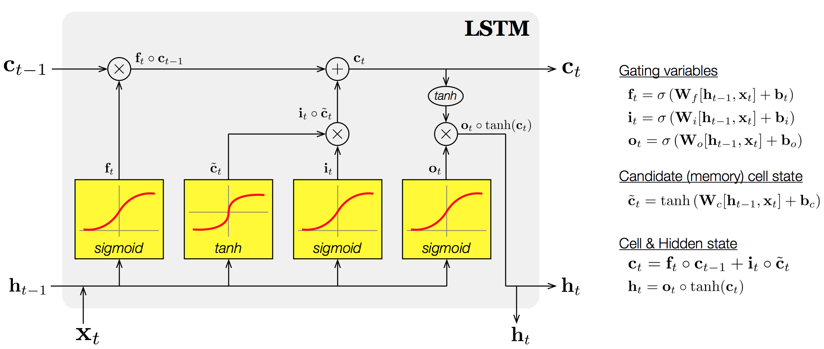
全圖

Slide 20
資源來源
https://medium.com/@ken90242/machine-learning%E5%AD%B8%E7%BF%92%E6%97%A5%E8%A8%98-coursera%E7%AF%87-week-3-2-cost-2e7aa00e8c4a
https://ckmarkoh.github.io/blog/2015/06/06/neural-network-recurrent-neural-network/
http://doremi2016.logdown.com/posts/2017/02/28/1351811
http://hemingwang.blogspot.tw/2017/03/airecurrent-neural-network.html
http://colah.github.io/posts/2015-08-Understanding-LSTMs/
https://github.com/llSourcell/LSTM_Networks/blob/master/LSTM%20Demo.ipynb
http://jackon.me/posts/why-use-cross-entropy-error-for-loss-function/

